Slide 1

Earliest castles were not very comfortable places in which to live. They were built primarily as the lord’s headquarters and provided shelters for the lord and his armies. In case of attack, they also provided a place for the safety of nearby villagers. As it became more common for the lord’s families and servants to occupy these castles, more and more buildings were added. Castles became worlds unto themselves. There were mills, bakeries, stables, smithies, mews for the hawks and more.

Slide 2
Schloss Neuschwanstein
Schloss Ribbesbüttel
Gifhorn See Schloss
Schloss Acarden Braunschweig
Schloss Charlottenburg
Schloss Weinegaröde
Schloss Bückerborg
Burg Hohenzollern
Prague Castle
Belfast castle
Dunluce Castle
Carrickfergus Castle
Sketrick Castle
Schloss Hohenschwangau

Slide 3
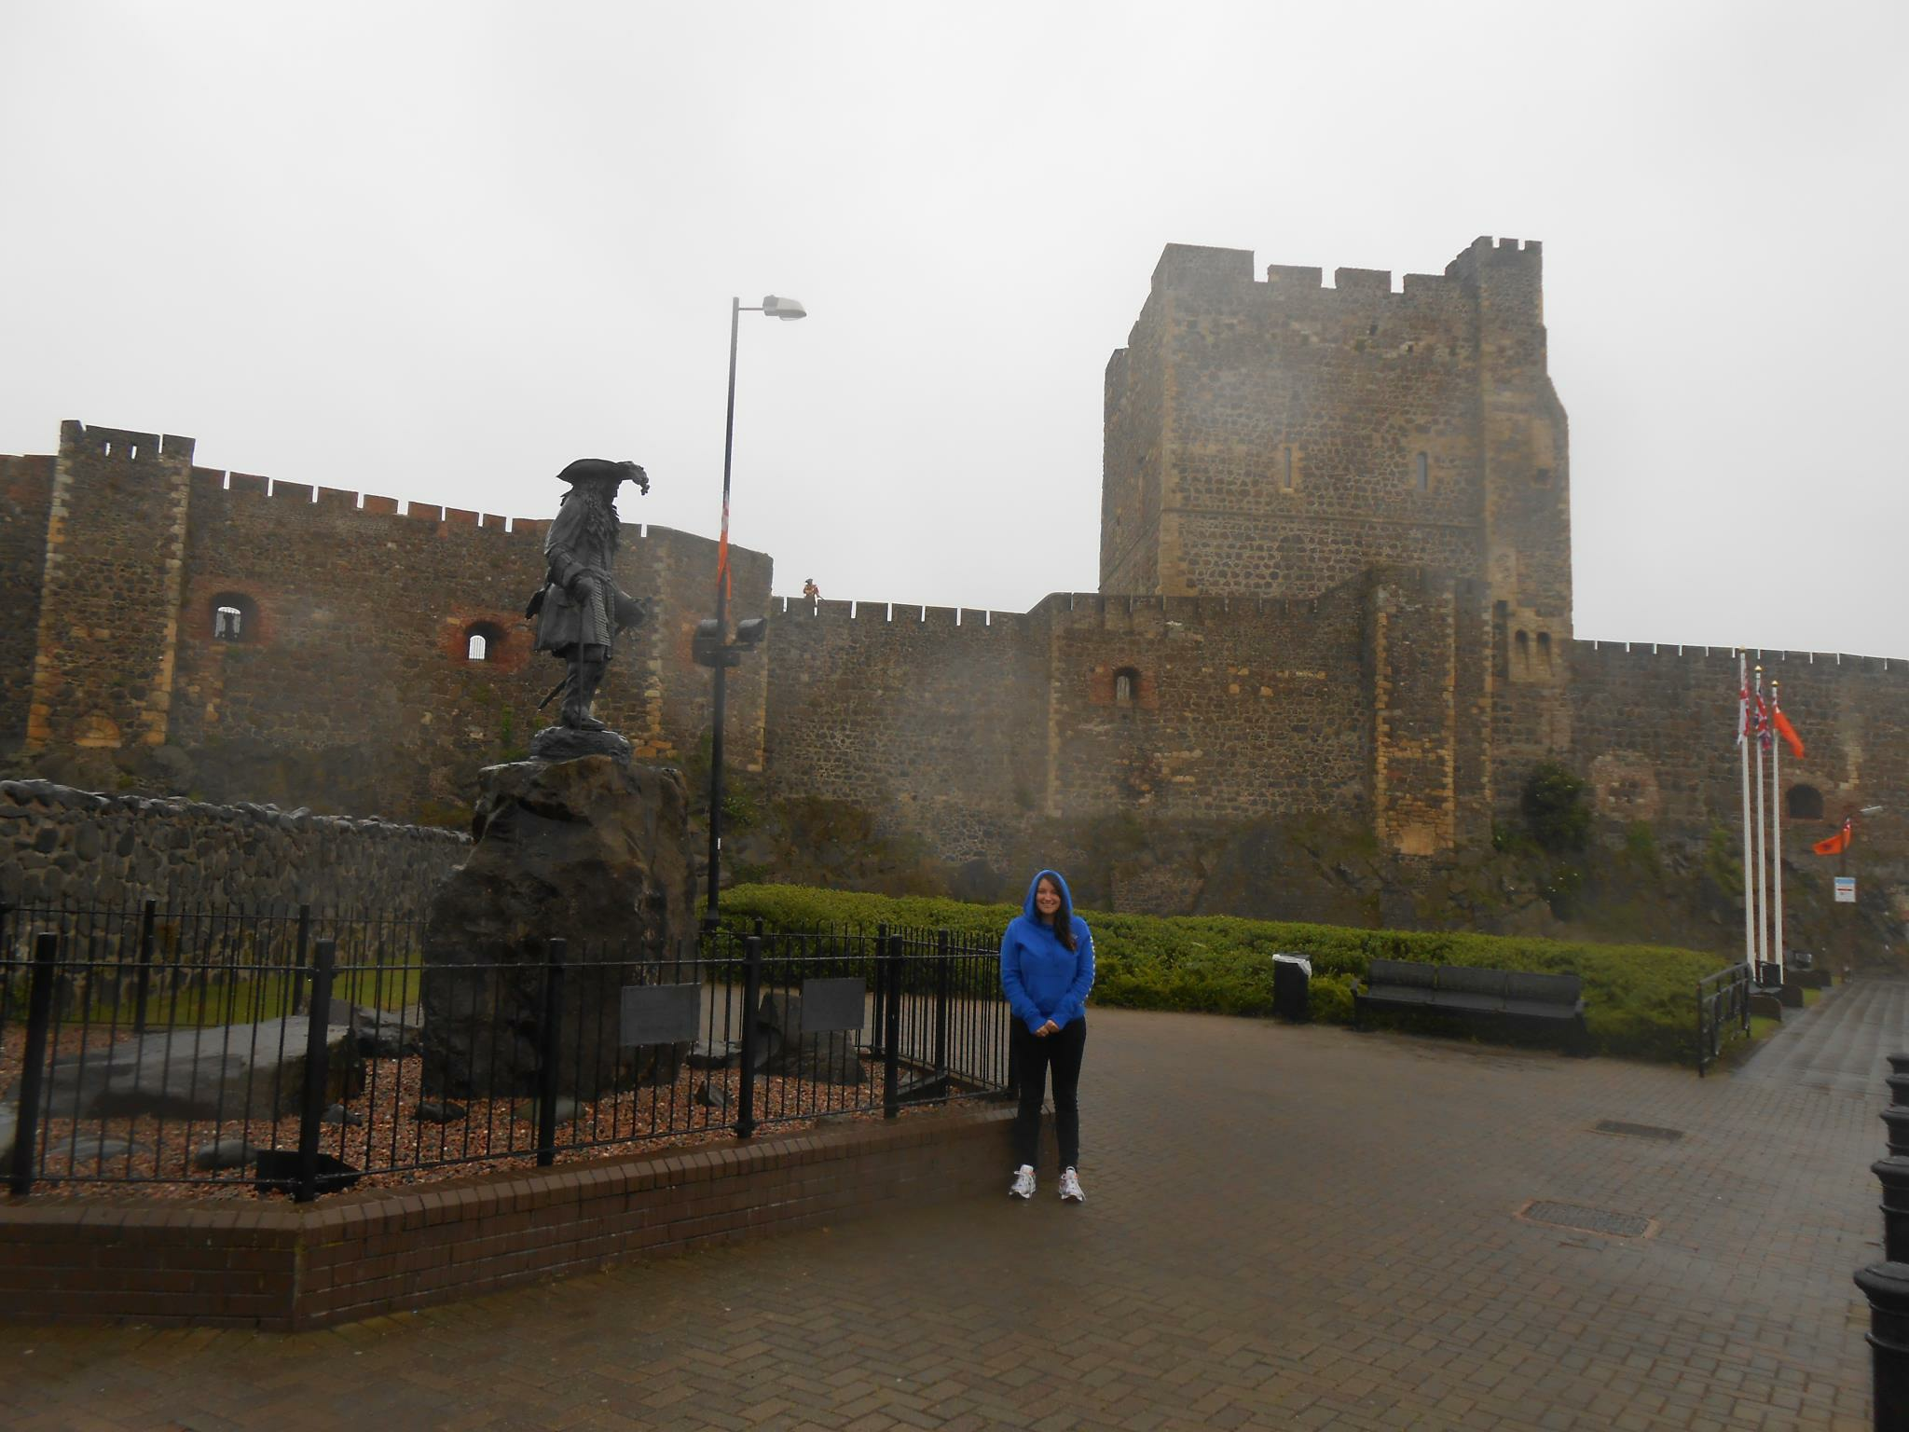
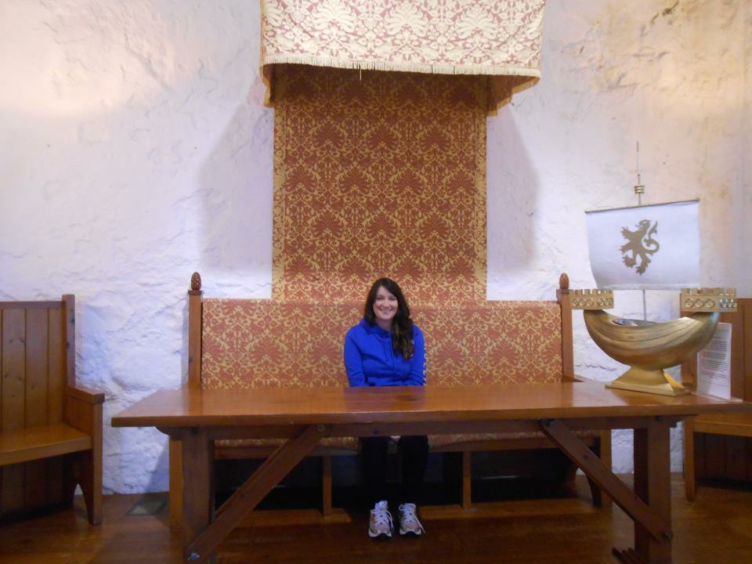
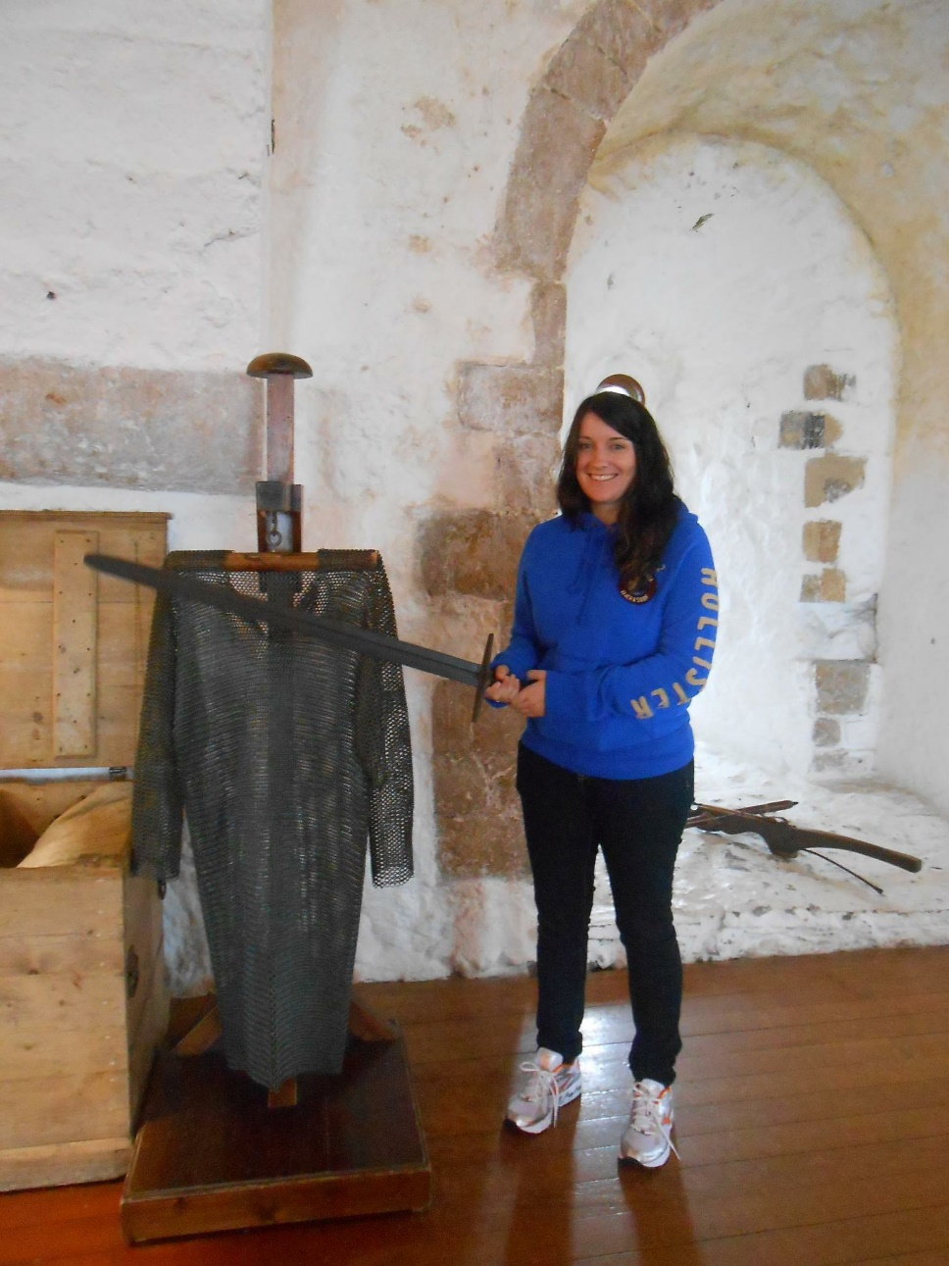

Slide 4
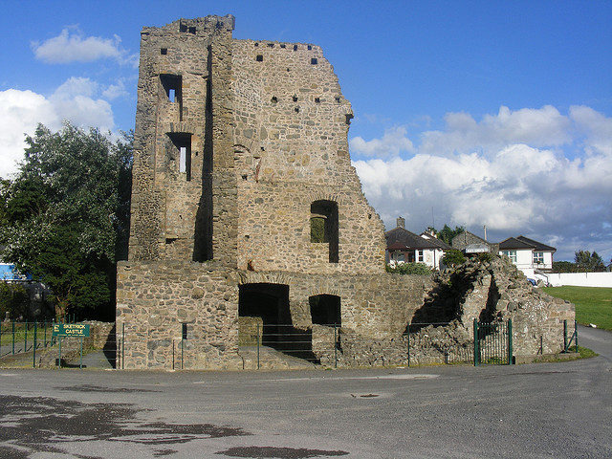
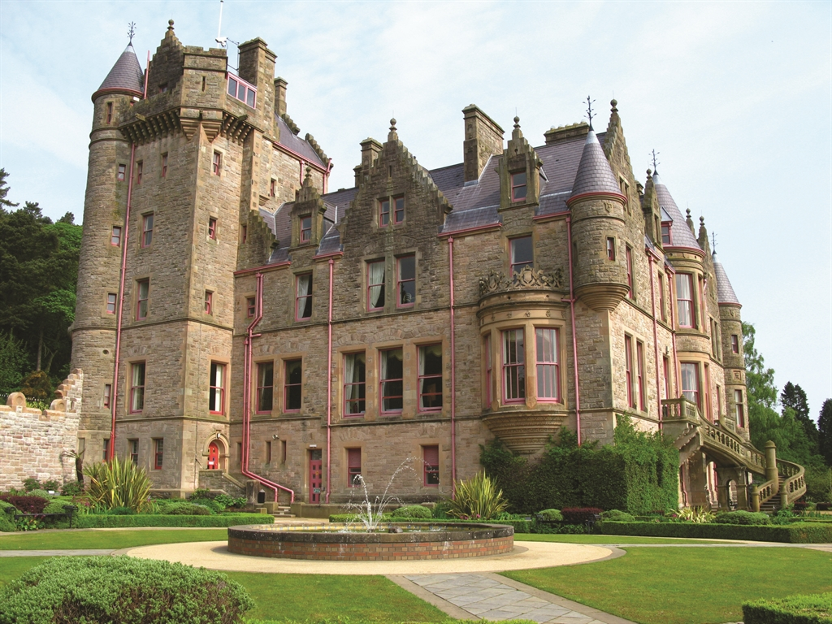
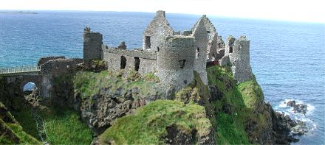

Slide 5
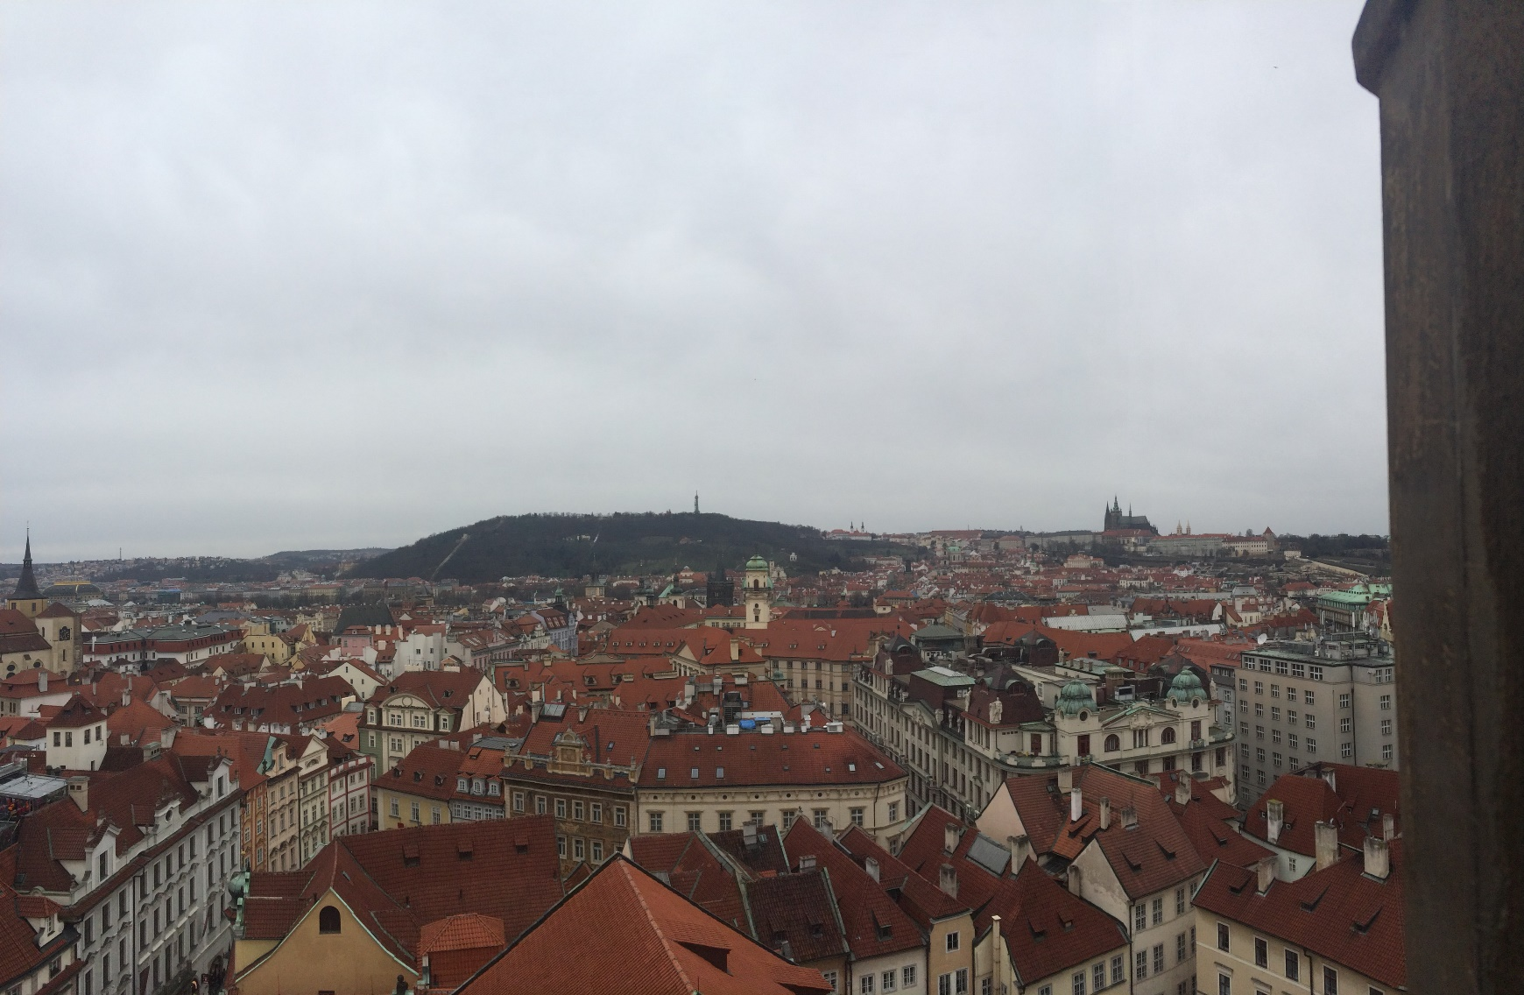
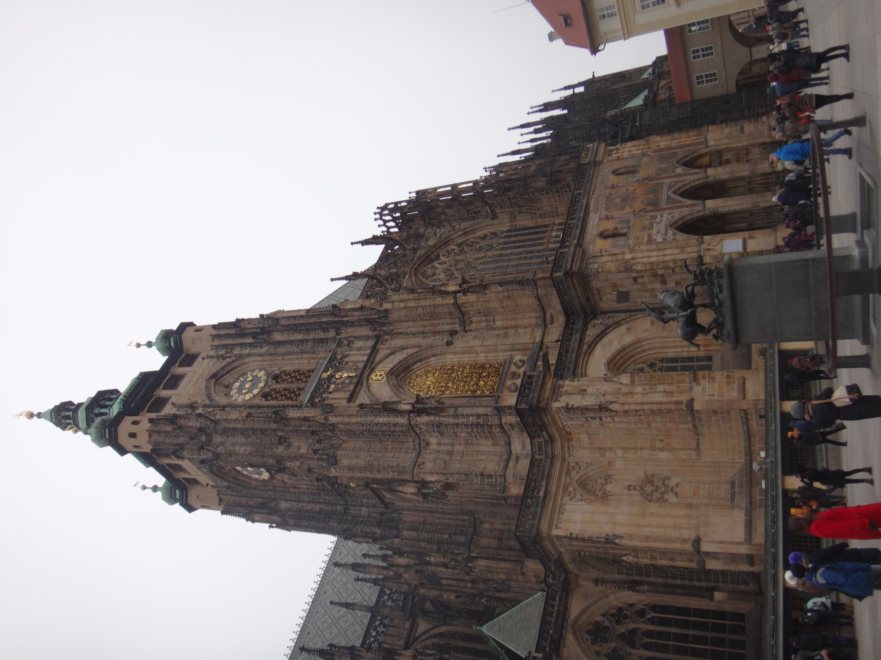
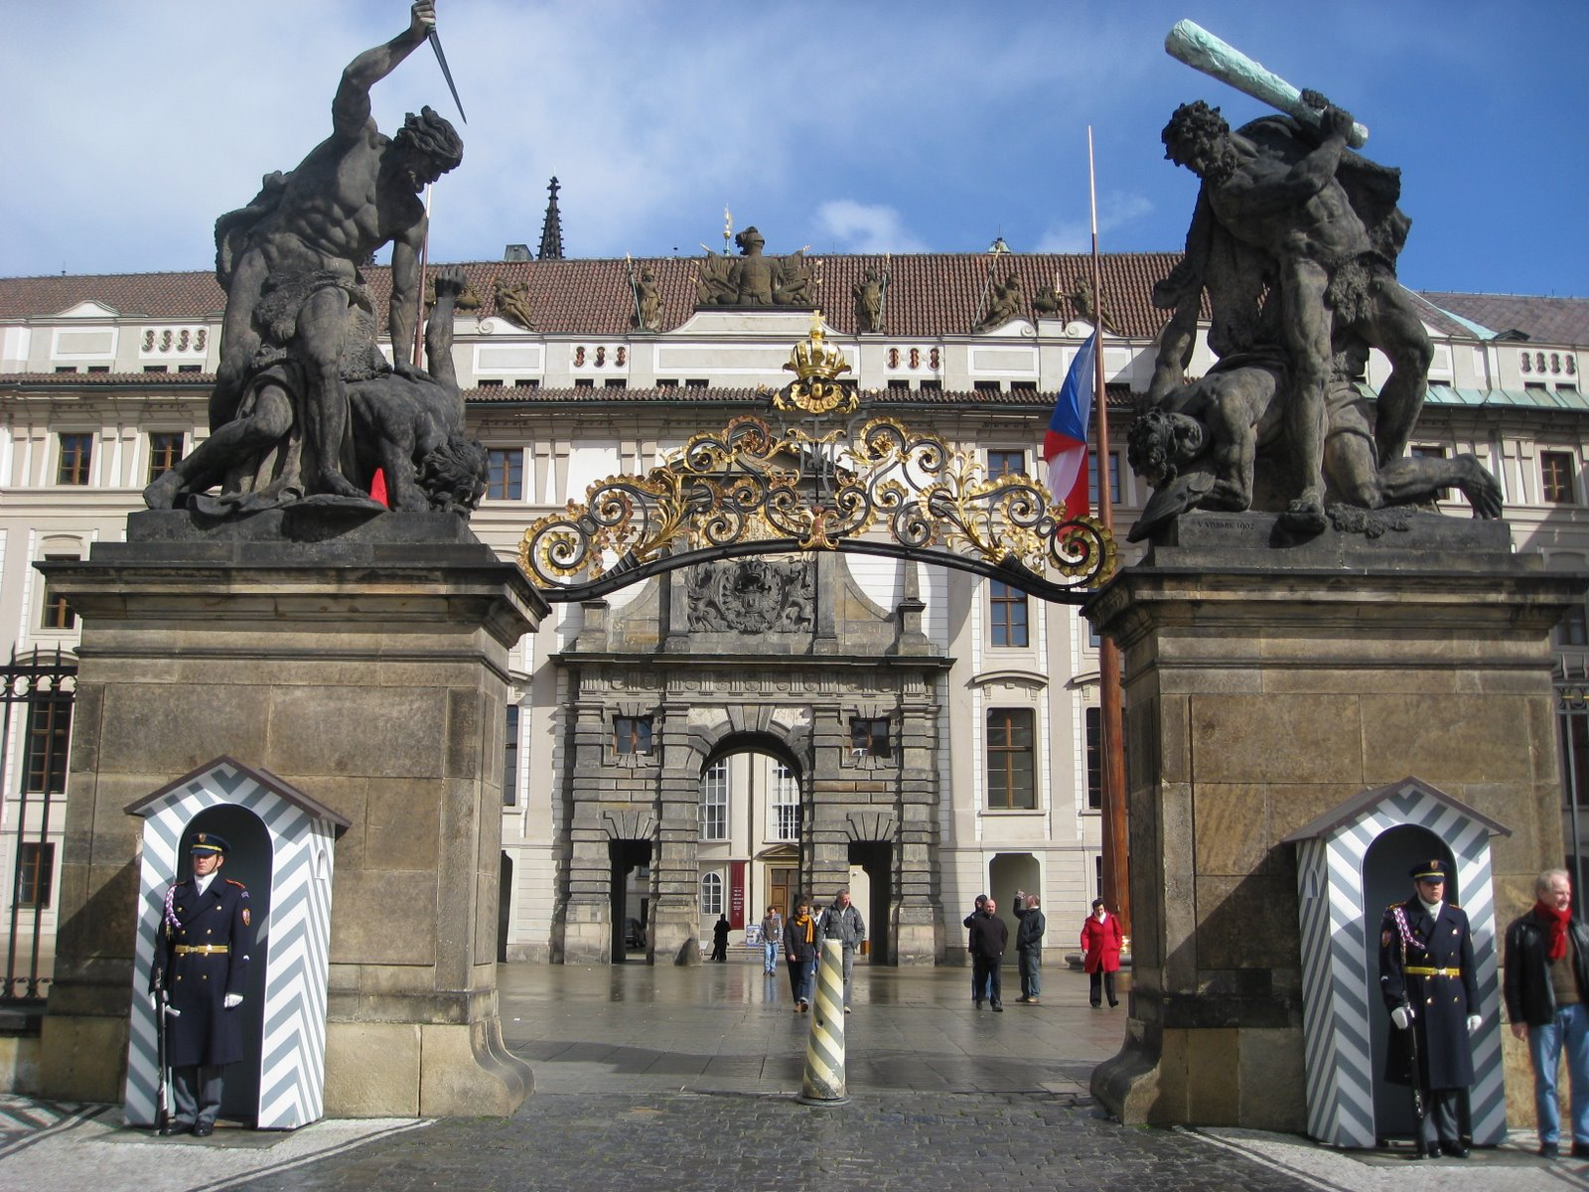

Slide 6
Key Notes
Page 102

Slide 7
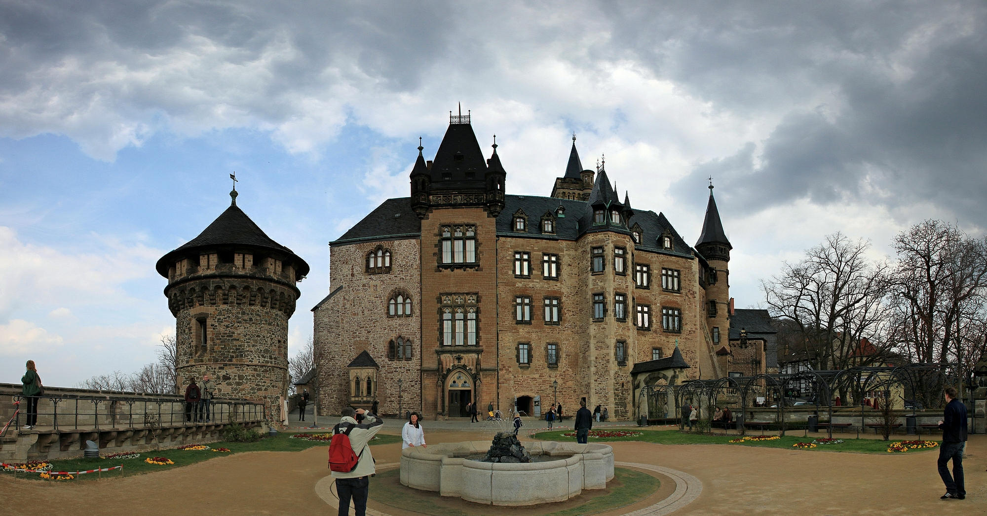
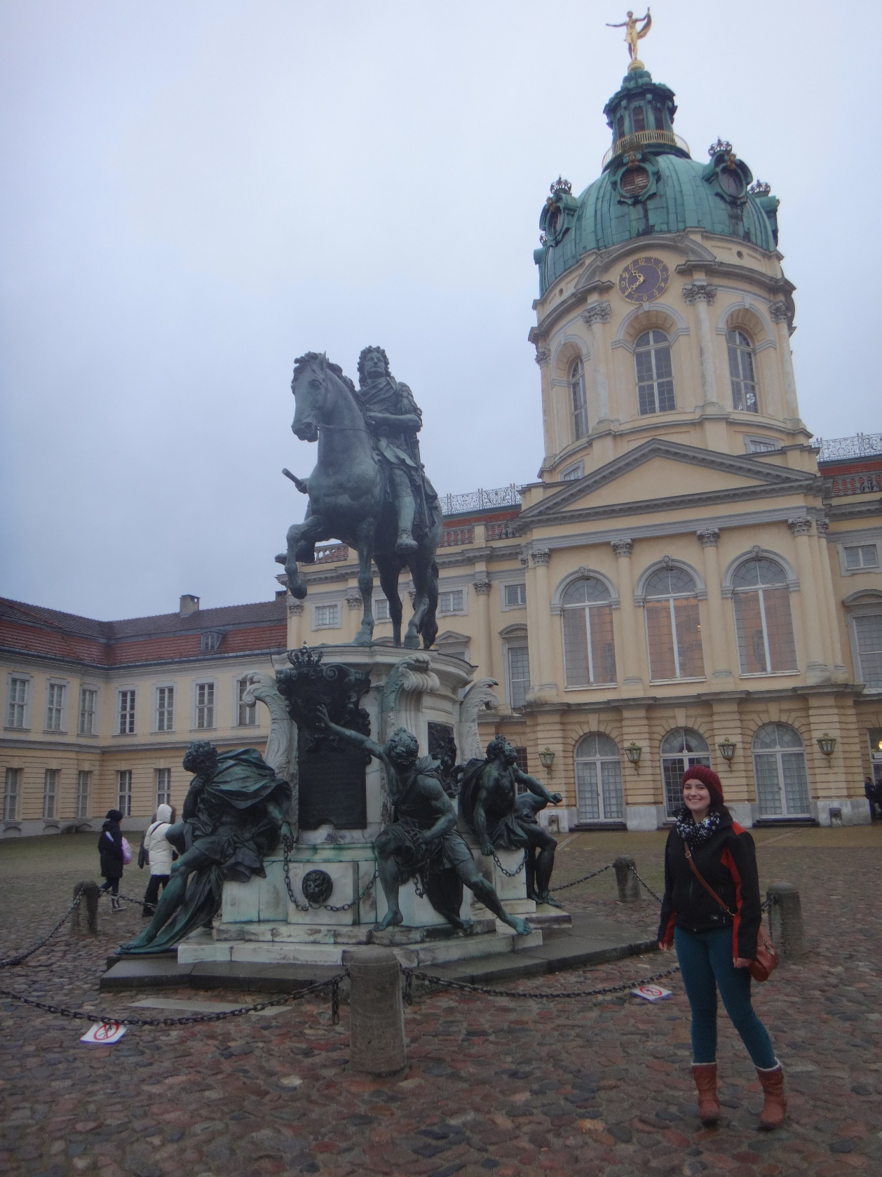
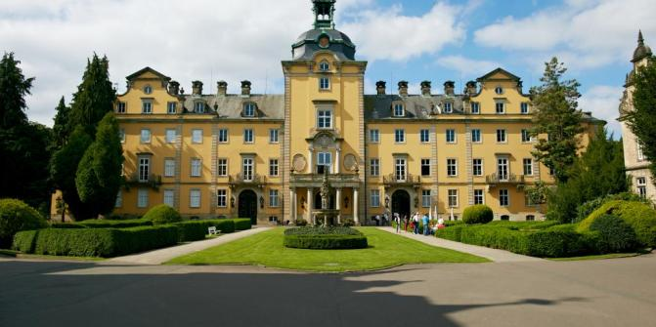

Slide 8
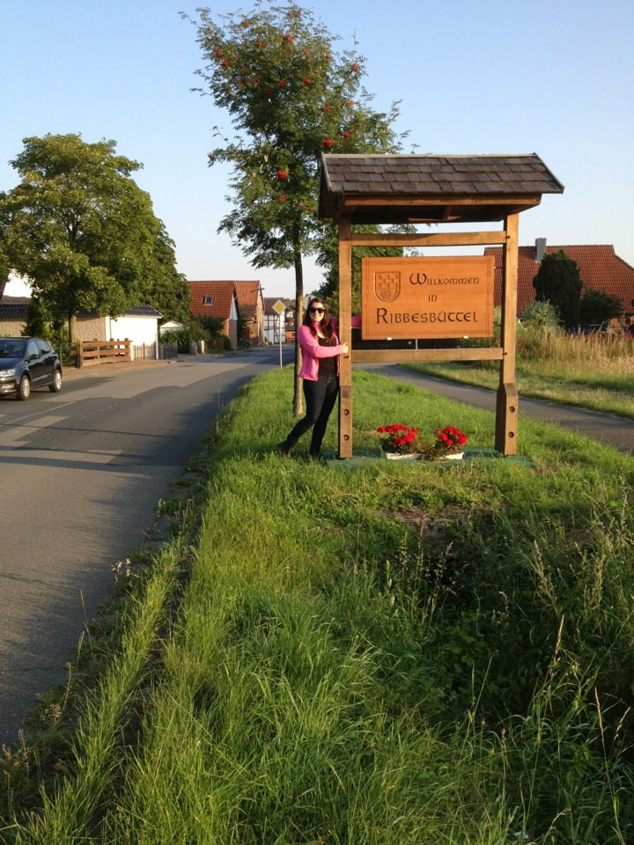
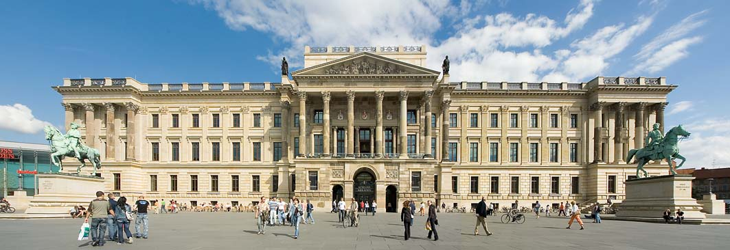
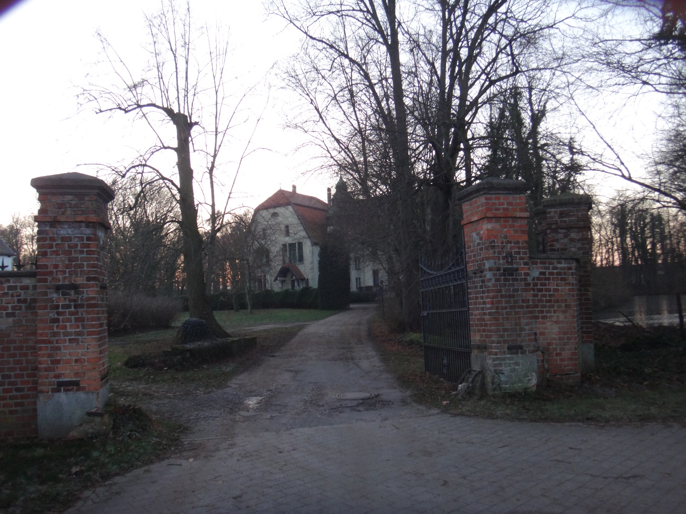
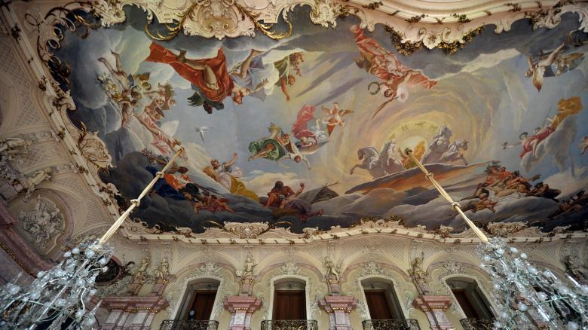

Slide 9
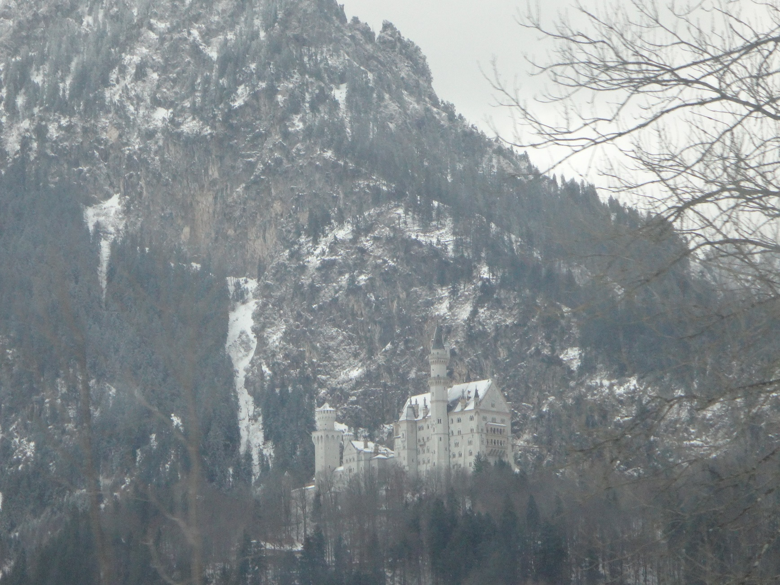
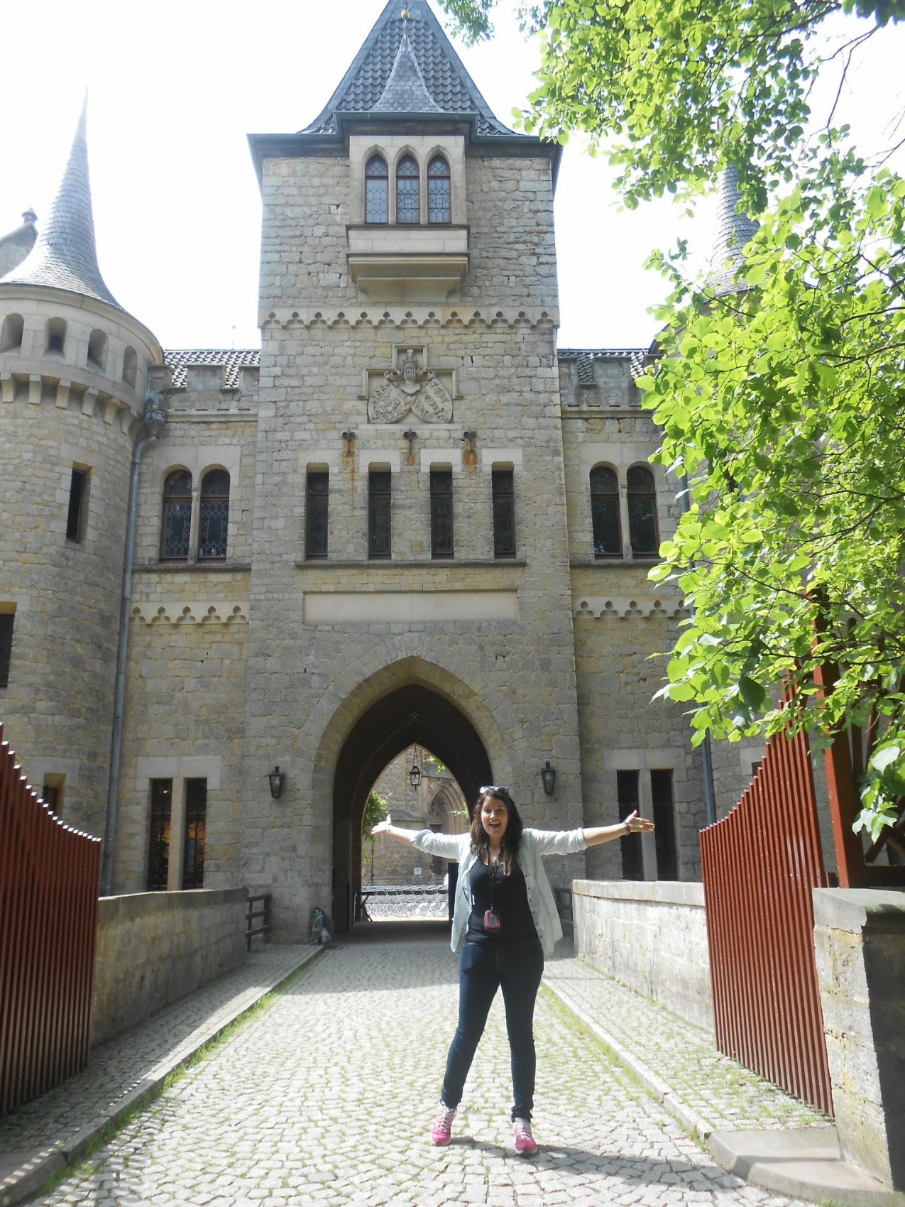
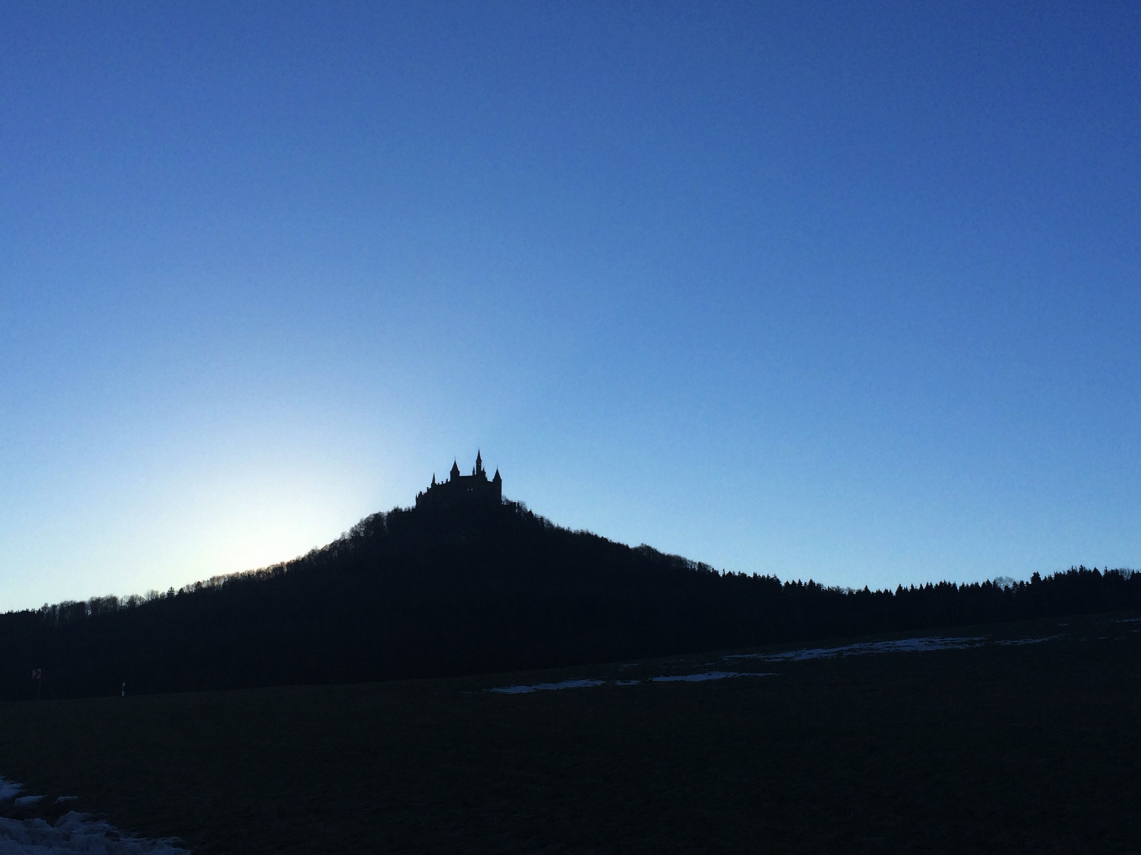

Slide 10
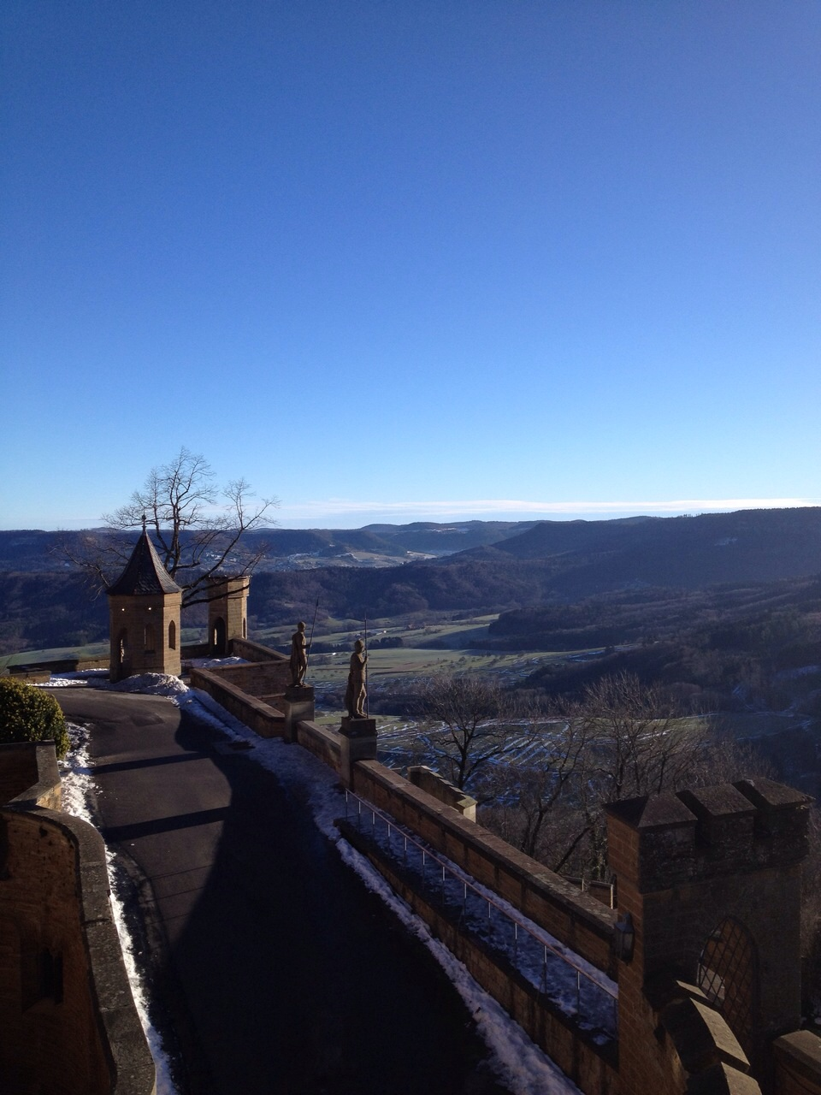
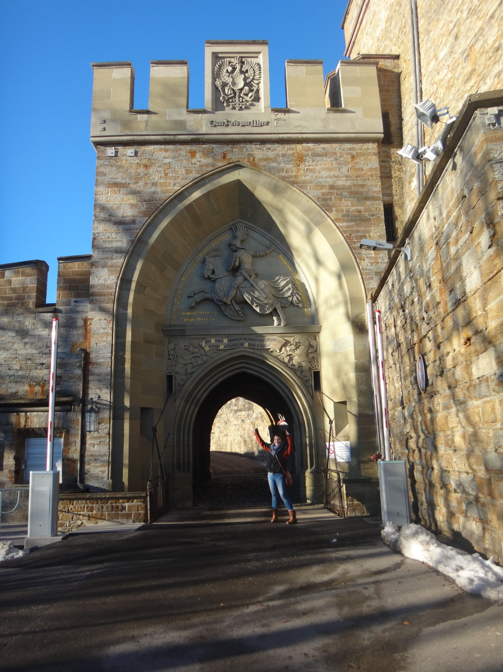

Slide 11
